Slide 1

Transparency Report
TheVIT AS
2024

Slide 2


Innhold
About TheVIT
Conduction this yars due diligence assessment
Assessed risk
Risk-mitigating measures
Questions regarding this statement

Slide 3
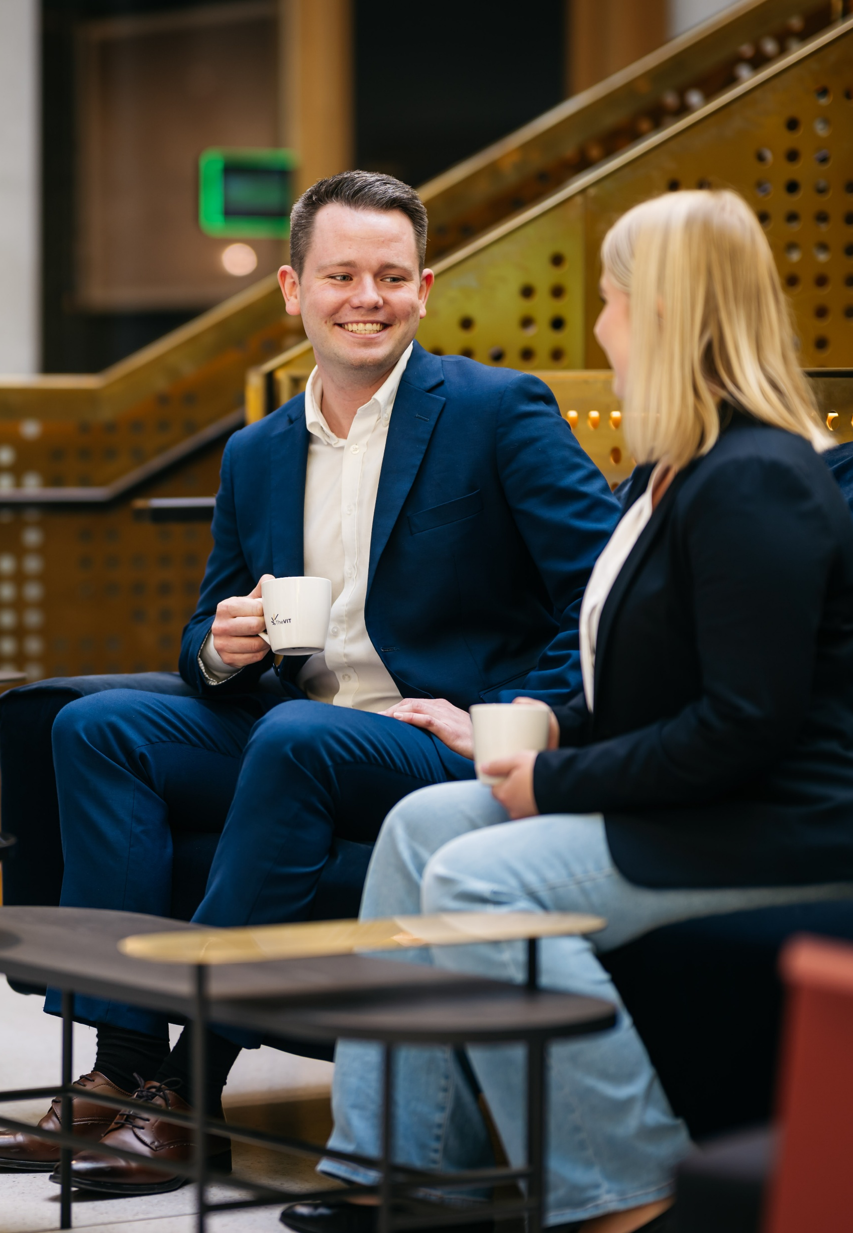
About TheVIT
TheVIT provides consulting services within the areas of finance, HR, sustainability, and technology in the Norwegian business sector. In addition, in 2025 we established a subsidiary in Denmark operating within the Danish business community.
TheVIT is a knowledge-based company with highly educated employees – both experienced professionals and recent graduates from colleges and universities – operating within a Norwegian working environment characterized by solid legislation, a high degree of organizational freedom, a free press, and active supervisory authorities. We strive for an open and inclusive corporate culture, a good working environment, as well as favorable economic conditions and predictable frameworks for our employees.
Our work with sustainability is anchored in the company through our own ESG department, which is also represented on the management team. We have embedded our commitment to human rights and decent working conditions both within our own operations and throughout the value chain through internal routines, ethical guidelines, and established processes for involvement, dialogue, and reporting

Slide 4
This statement covers the financial year 2024. We have carried out our due diligence assessment in line with the principles of the OECD Guidelines for Responsible Business Conduct and have conducted an overall risk assessment for the following matters:
The risk of violations of fundamental human rights.
The risk of breaches of decent working conditions, including health, safety, and the working environment at the workplace and in the value chain.
As a knowledge-based company, we have no physical products or production, but we do have suppliers providing the tools and services we need to support our customers and maintain our operations.
Conducting this year due diligence assessment

Slide 5
Assessed risk
Through our due diligence assessment, we have identified three main areas where our industry may be exposed to the risk of poor working conditions:
Own employees; Workload and working environment
Although the consulting industry often consists of highly educated employees and generally good working conditions, the industry may be characterized by risks related to employees working on an assignment- and project-based basis, and to a large extent being engaged with and at clients. Such risks may include experiencing high work pressure, imbalance between work and private life, as well as a potential lack of a stable social environment.
To remain an attractive workplace where employees and leaders thrive over time, we have established solid internal routines and processes across a number of areas, which together help ensure that employees experience TheVIT as a safe and inclusive workplace, combined with a performance culture that allows for the consideration of individual needs and preferences. Examples of this include strong regulations of client and assignment agreements, continuous follow-up of employees, established channels for dialogue and reporting, as well as internal routines ensuring flexibility and facilitation during different life stages. With these measures, we consider the risk within our company to be low, and we also have strong mechanisms in place to maintain continuous attention to general risk factors within the industry.
2. Social dumping in cleaning and catering
Cleaning and catering services have been identified as areas with moderate to high risk of social dumping by the Research Council of Norway, NTL, and the government’s action plan against social dumping. As a measure, in the spring of 2025 TheVIT followed up with our suppliers for cleaning and catering at all our locations in Norway. Based on collected and available information, we assess the likelihood of social dumping occurring to be low.
3. Purchased IT equipment
The value chain for the IT equipment we use includes both distributors and retailers. Since we purchase through several intermediaries, we have no direct contact with the production stage. This means that we have limited influence over practices in production, but we acknowledge this as a structural challenge and include it in our assessment.
Even though we do not have direct control over these secondary tiers in the supply chain, we take the following measures to ensure responsibility:
We stay updated on available information and media coverage related to relevant product groups, producing countries, and brands.
We continuously assess whether there is a need for action in line with recommendations from Norwegian authorities and developments in the market.

Slide 6
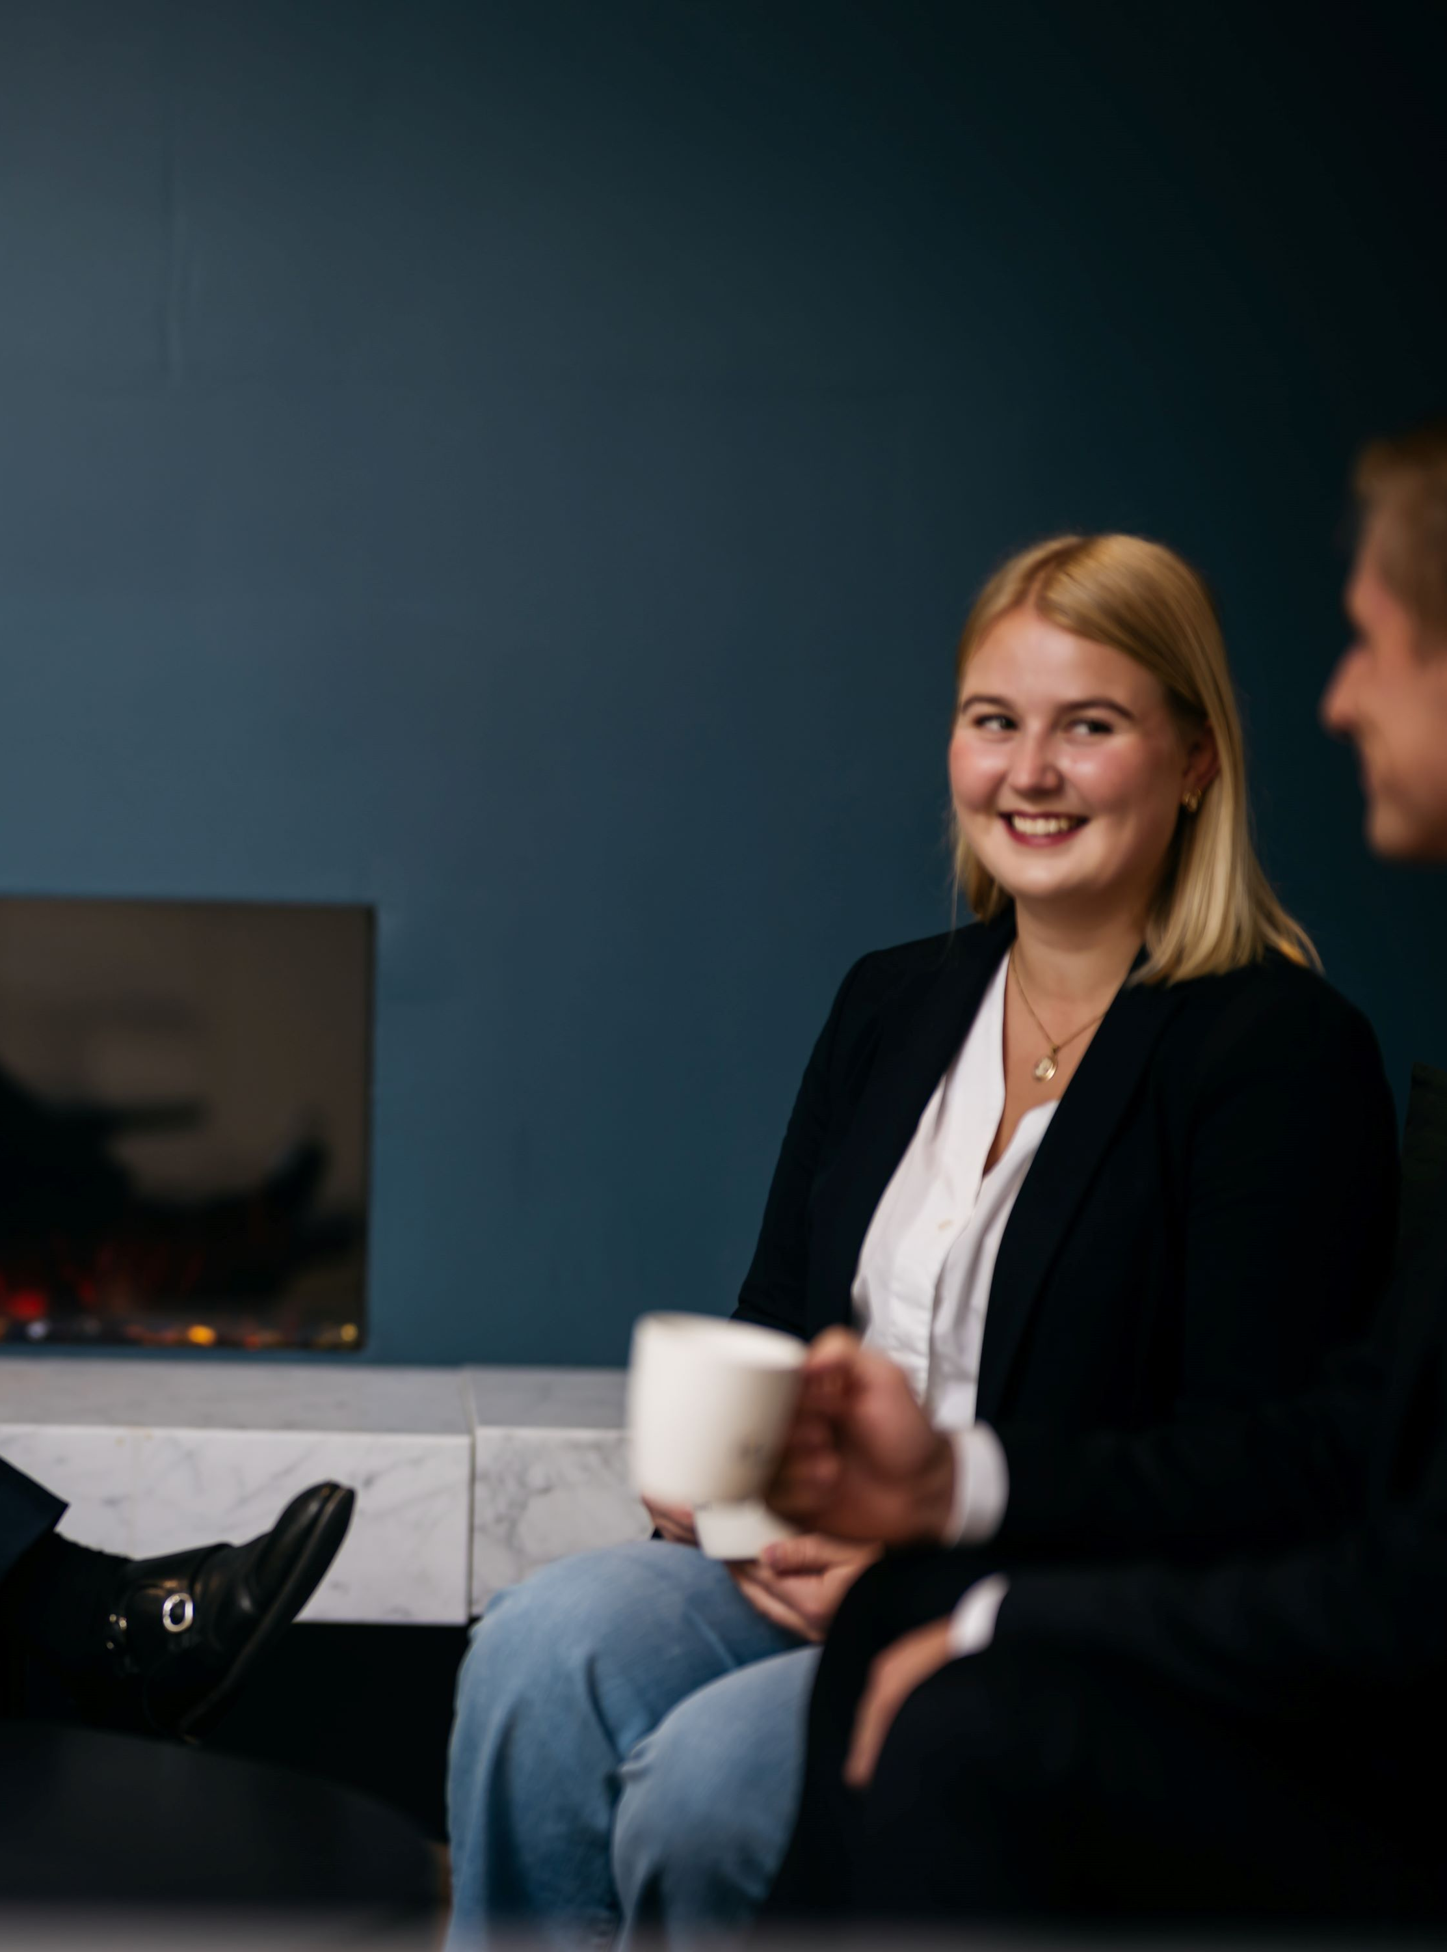
Risk-mitigating measures
For our Norwegian suppliers, the inherent risk of violations of human rights and decent working conditions is considered low. This is partly due to the fact that suppliers operate in a well-regulated labor market with strong institutions, clear legal requirements, and active supervision.
Based on this risk assessment, we have not implemented specific measures beyond the following:
Regular contract follow-up, which includes dialogue with suppliers when entering into and renewing agreements, with a focus on professionalism, compliance with legislation, and delivery reliability.
Follow-up in the event of deviations: should suspicions or indications of breaches of working conditions or rights arise, these will be addressed through direct dialogue and, if necessary, escalated.
For our global suppliers (IT equipment), we have limited direct influence. We choose to only purchase through actors we consider serious and who have established routines for responsible procurement and supplier follow-up. As part of our annual statement, we will also evaluate the adequacy of these measures.
To further strengthen this work, in 2025 we will prioritize the following activities:
Updating our Code of Ethics and further integrating it into training.
Updating routines for procurement, contracts, and supplier follow-up.
Evaluating the need for updating our whistleblowing procedures.
Documenting our routines for annual due diligence assessments to make this process more accessible in the coming years.

Slide 7

Questions regarding the statement?
Any inquiries related to this statement, or to our work on human rights and decent working conditions, can be directed to: sustainability@thevit.no.
We will respond to inquiries within 3 weeks.
Borad of Directors, TheVIT AS
June 2025

Slide 8
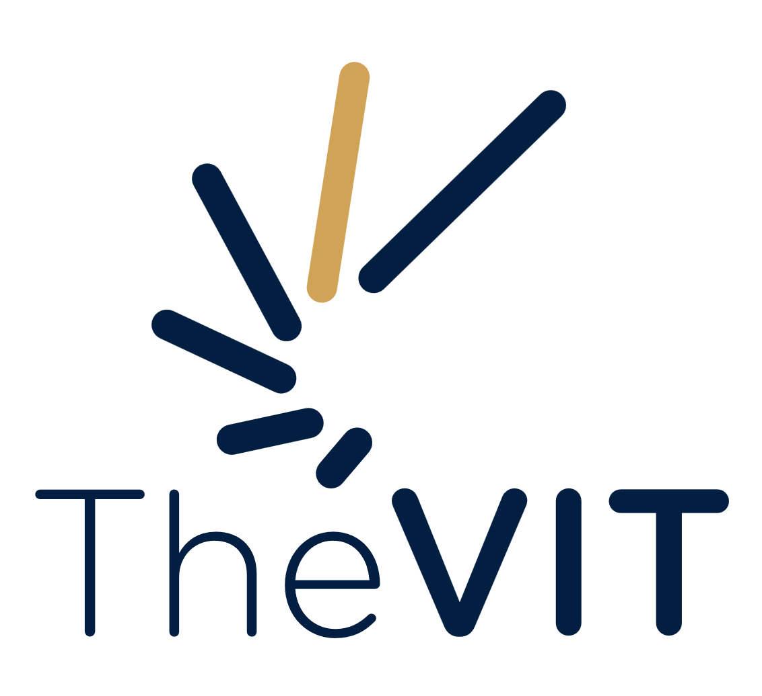
www.thevit.no

